Slide 1
Dynamic and Static Approaches Comparison for Test Suite Reduction in Industry
Vincent Blondeau

Slide 2
Introduction
Testing takes time!
Tests only executed during the night
No immediate feedback for the developer
Notes:
CSMR (European Conference on Software Maintenance and Reengineering) -> rank C

Slide 3
Introduction
Goals
Select tests to relaunch after a change in the source code
Win time!
Comparison of approaches
Call graph analysis by static approach
Comparison with dynamic approach
Notes:
CSMR (European Conference on Software Maintenance and Reengineering) -> rank C

Slide 4
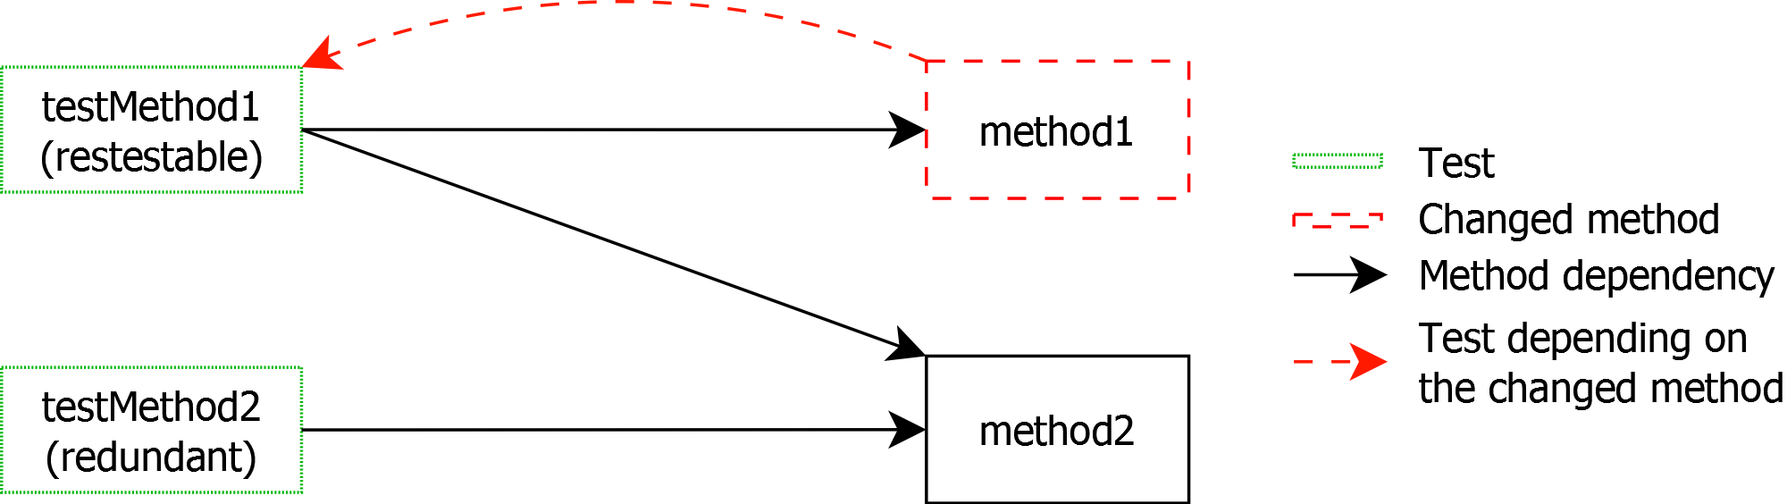
Example
Simple case

Slide 5
Two approaches
Dynamic Approach
Execute the tests
Map the tests to the covered code
Relaunch the tests related to changed source code
Properties
Dependent to the test data
The tests have to be executed

Slide 6
Two approaches
Static Approach
Create a model of the system
Navigate the call graph from a changed source code to find the tests
Properties
Allows to find other scenarios
No test execution

Slide 7
Overview
Problems classification
Experiments
Results
Notes:
Effets de bord potentiels sur les tests

Slide 8
Problems
Issues classification
Third Party breaks
Multi-program breaks
Dynamic breaks
Polymorphism breaks

Slide 9
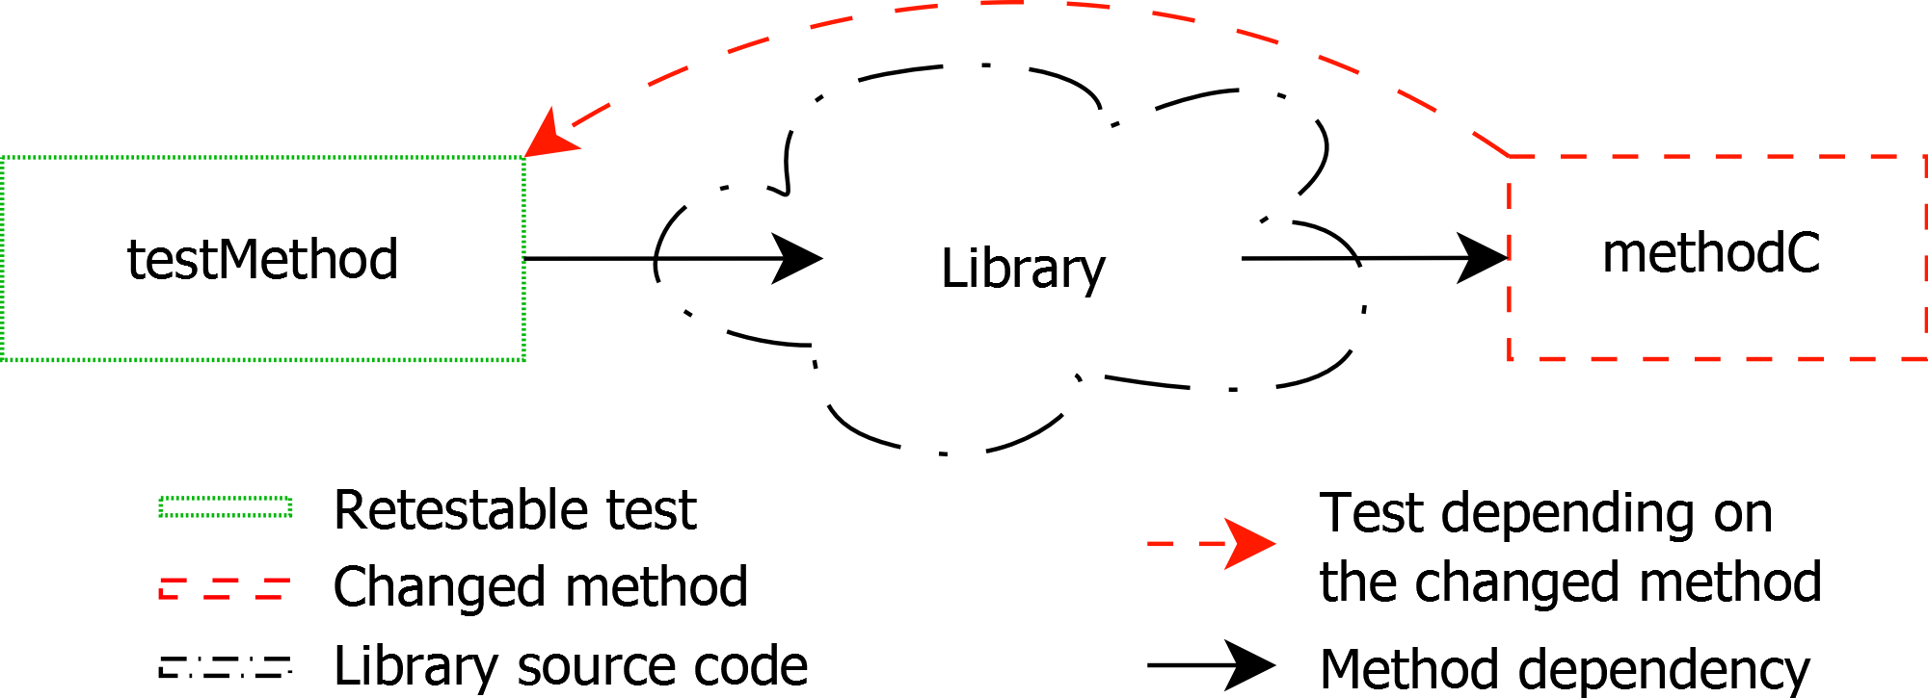
Third Party breaks: Libraries

Slide 10
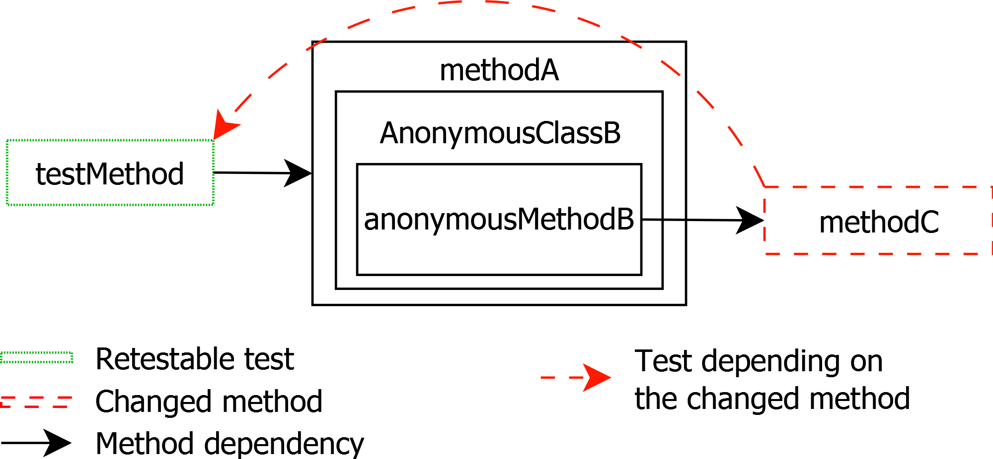
Third Party breaks: Anonymous Classes

Slide 11
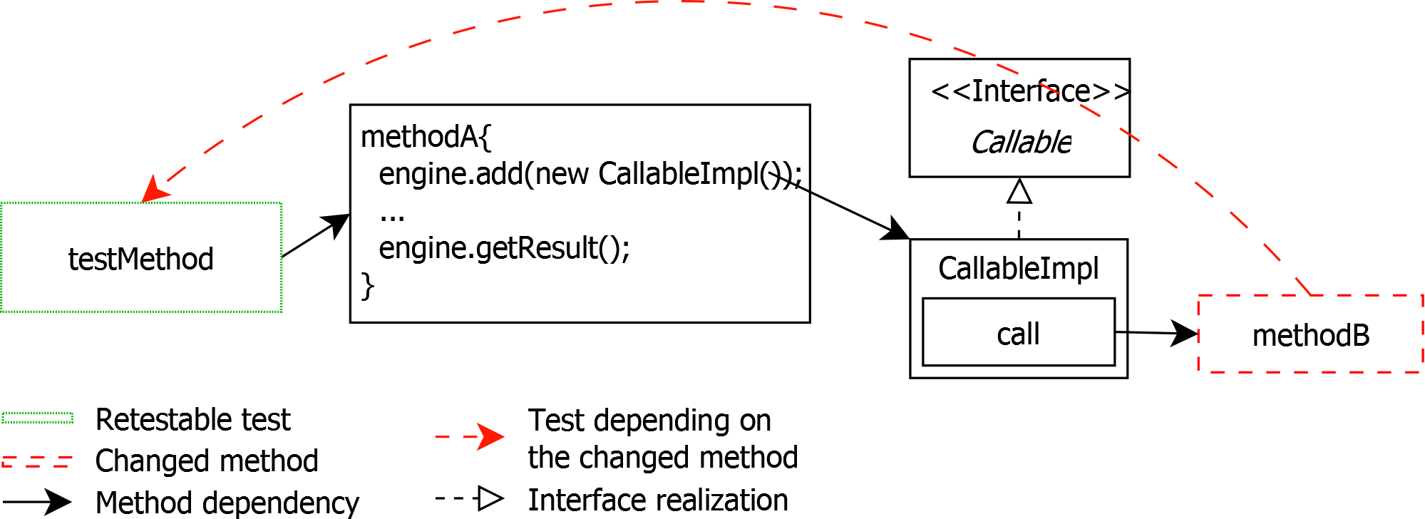
Third Party breaks: Delayed Execution

Slide 12
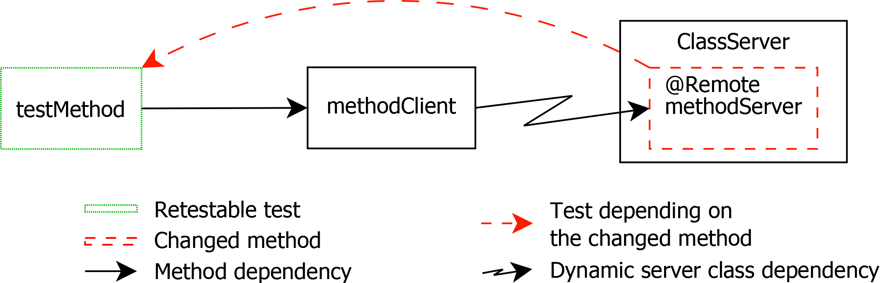
Multi-program breaks: Annotations

Slide 13
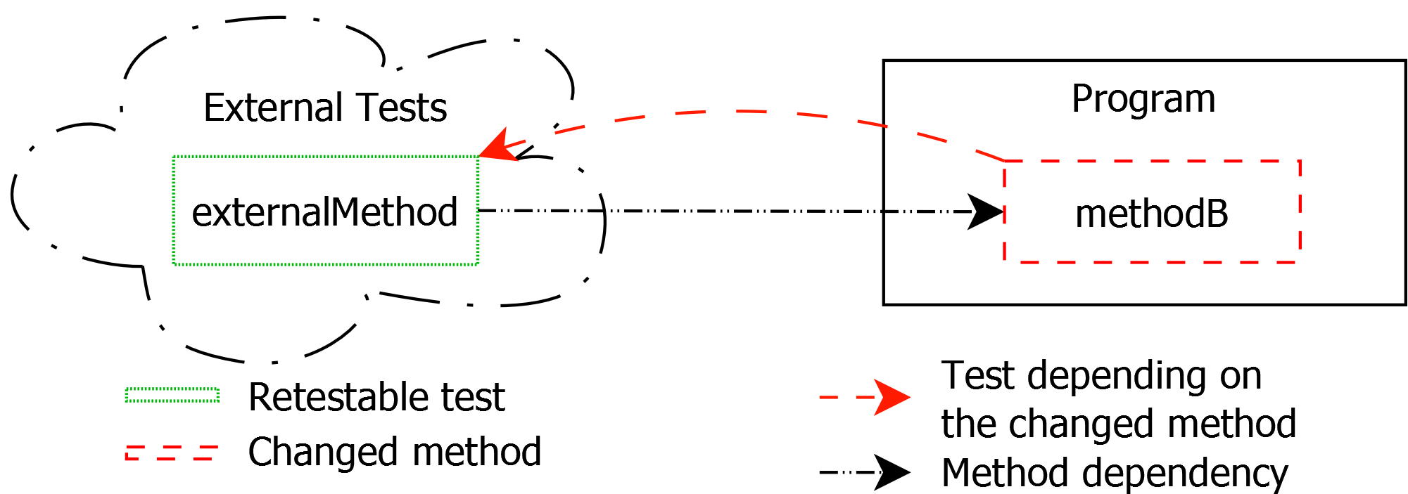
Multi-program breaks: External Tests

Slide 14
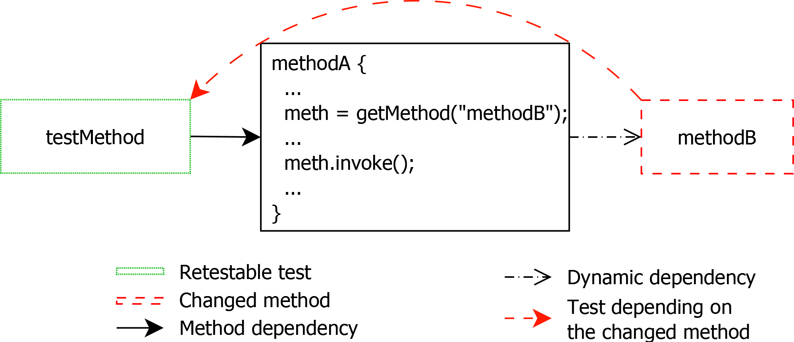
Dynamic breaks: Dynamic Execution

Slide 15
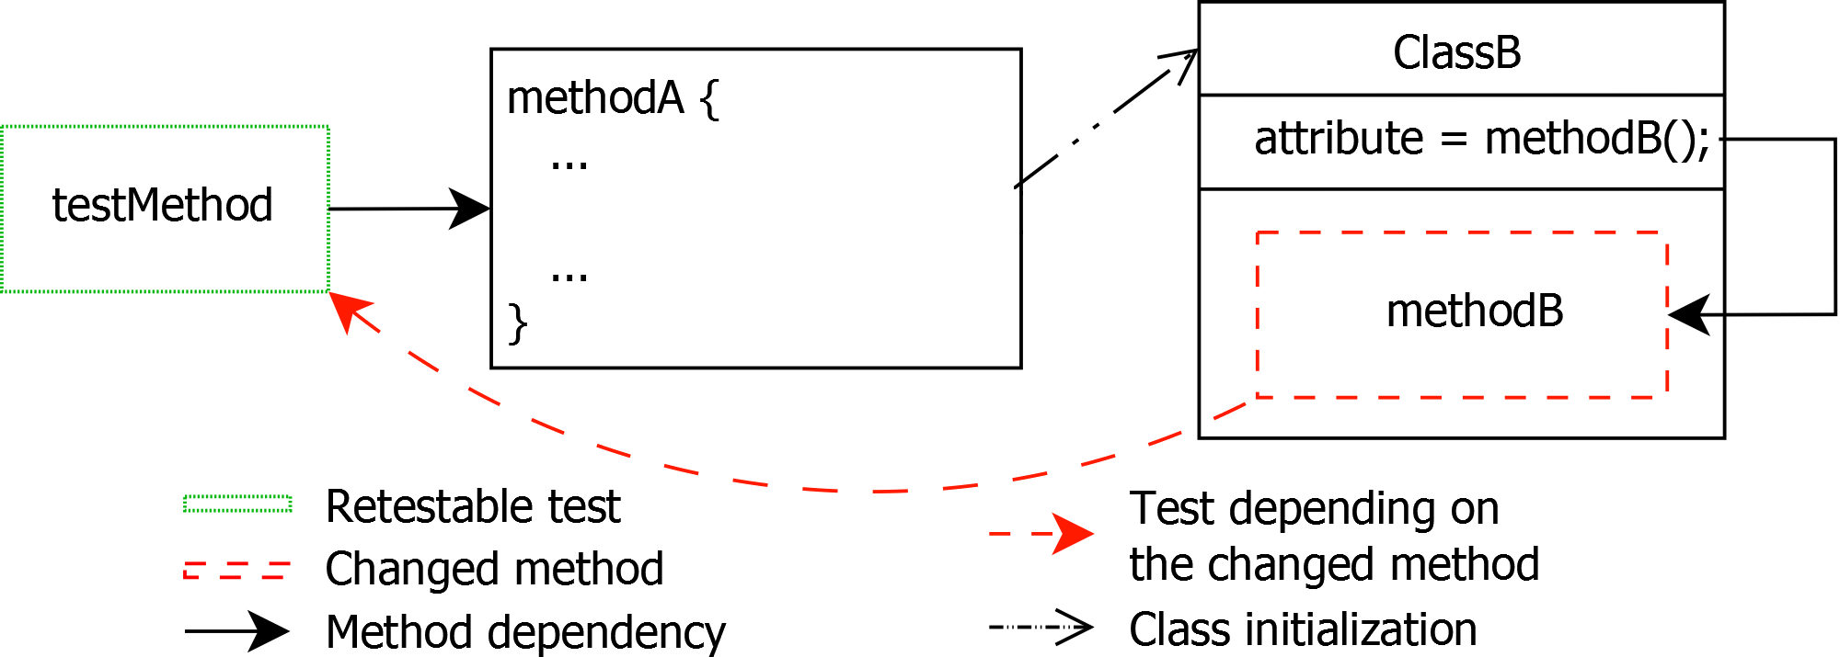
Dynamic breaks: Attribute Initialization
ClassB b=new ClassB()

Slide 16
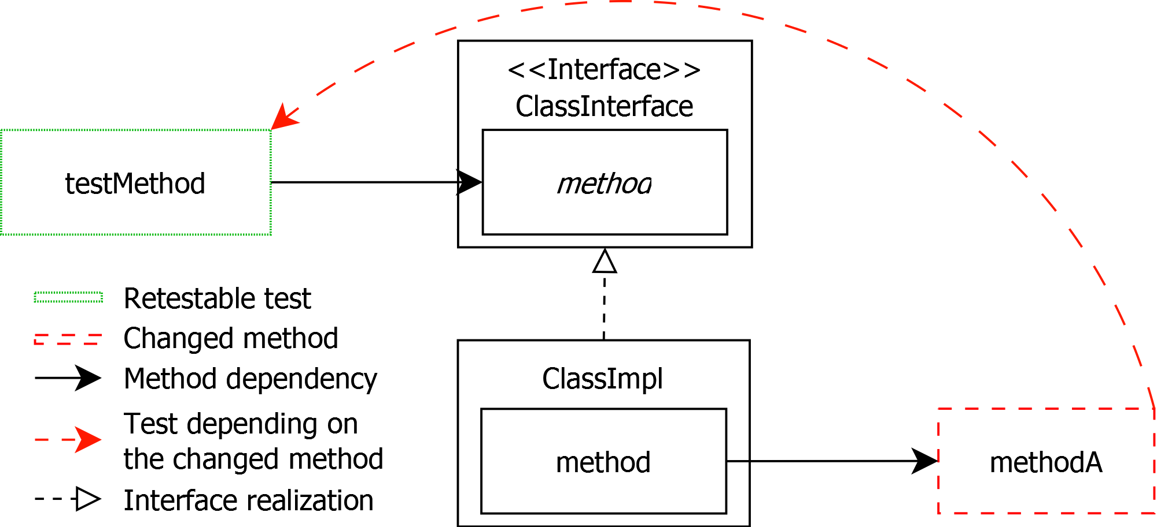
Polymorphism breaks: Interfaces
method

Slide 17
Overview
Problems classification
Experiments
Results
Notes:
Effets de bord potentiels sur les tests

Slide 18
Research Questions
What is the impact of a finer granularity?
What is the impact of the third-party breaks issue?
What is the impact of the dynamic breaks issue?
What is the impact of the polymorphism breaks issue?
Can we combine the solutions to different problems?

Slide 19
Granularity
Instructions not studied
Heavy to model
Complex
Invocations abstracted at classes and methods level

Slide 20
Experiment
Compared several static approaches resolving the issues
Dynamic approach is the oracle
Flaws to be studied
Considered each covered method as changed

Slide 21
Metrics
Number of selected tests
Ratio of the total test suite to relaunch
Precision
How many selected tests are relevant?
Recall
How many relevant tests are selected?

Slide 22
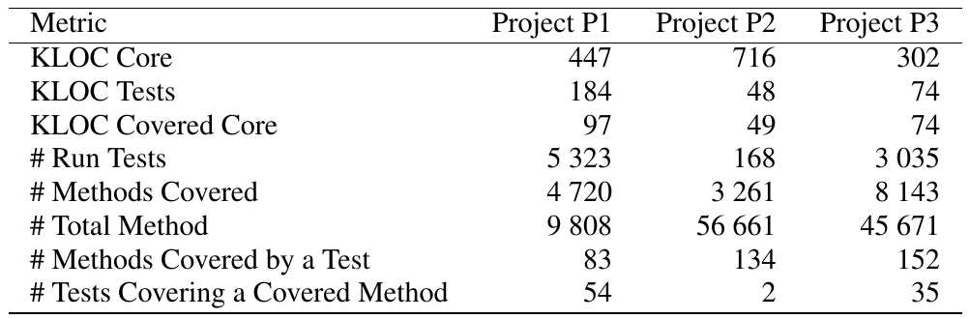
Project metrics

Slide 23
Overview
Problems classification
Experiments
Results
Notes:
Effets de bord potentiels sur les tests

Slide 24
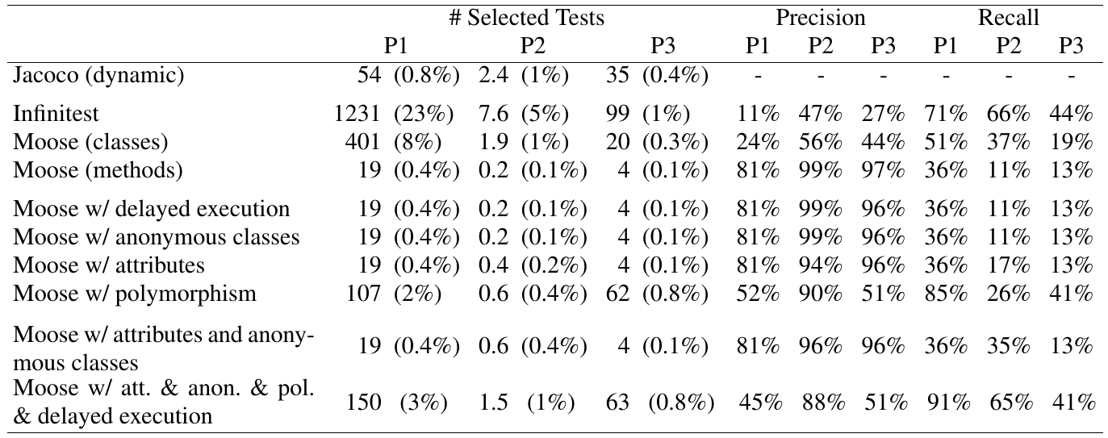
Results
What is the impact of a finer granularity?
Number of Selected Tests
Precision
Recall

Slide 25
Results
What is the impact of the third-party breaks issue?
Number of Selected Tests
Precision
Recall

Slide 26
Results
What is the impact of the polymorphism breaks issue?
Number of Selected Tests
Precision
Recall

Slide 27
Results
What is the impact of the dynamic breaks issue?
Number of Selected Tests
Precision
Recall

Slide 28
Results
Can we combine the solutions to different problems?
Number of Selected Tests
Precision
Recall

Slide 29
Conclusion
Problems
are intertwined
impact differently each project
have different solutions for a given break class
Dynamic analysis
Seems perfect, but:
Depends of the data used for the tests
Does not work on failling tests
Requires time to be performed
Implies a use of a depreciated model

Slide 30
Future Work
Implement for real applications
Some problems cannot be solved with only dynamic or static approaches
Hybrid appoach
Study more closely issue of dynamic approaches

